Slide 1
Gene Ontology tools and resources Antonia Lock
Objectives
To explain
What the Gene Ontology (GO) is and its limitations
Where GO annotations come from
How it is accessed
How it is used

Slide 2
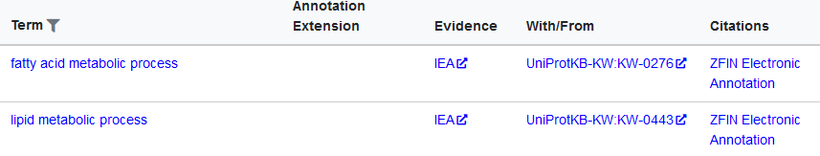
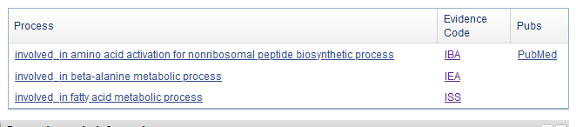
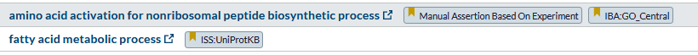
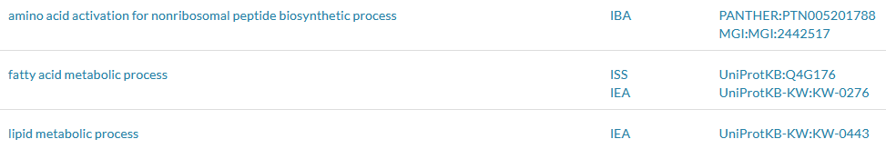
NCBI gene
AASDH aminoadipate-semialdehyde dehydrogenase
ZFIN
UniProt
Alliance

Slide 3
The Gene Ontology (GO)
The world’s largest resource on gene functions (http://geneontology.org/)
Aims to capture biological knowledge and to describe attributes of gene products:
In a species agnostic manner - allows transfer of knowledge between organisms
In language interpretable by humans and machines (ontologies)
Enables computational analyses for interpretation of high-throughput experimental and clinical data
Enables access to data at scale
Freely available
Two parts; the ontology and the annotations
An ontology is a dictionary of defined terms, but with hierarchal relationships to each other
An annotation is an association of a gene product with an ontology term

Slide 4
What GO is not
GO only describes ‘normal’ biological processes and functions
It does NOT cover pathological processes (e.g. disease) or functions only observed in vitro
It is not static
Both the ontology and annotations are reviewed and updated regularly
Always ensure you use up-to-date releases in analysis

Slide 5
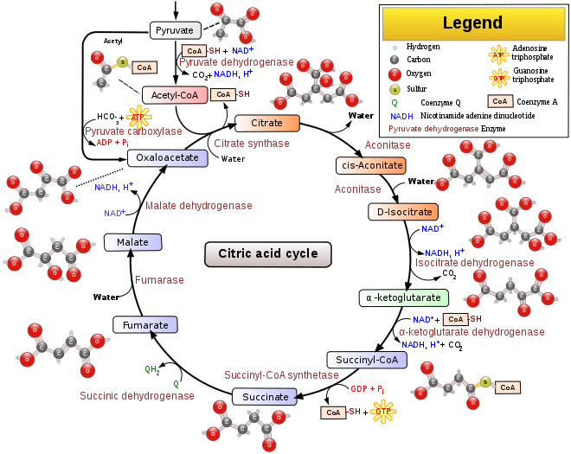
The Ontology
GO provides systematic language to describe gene products in three domains:
Molecular Function (MF)
Single step tasks
fumarase, protein kinase, cargo receptor
Biological Process (BP)
A recognized series of events
citric acid cycle, cell division, kidney development
Cellular Component (CC)
Where gene products localize
mitochondrion, lysosomal membrane, synapse
Image credit: Wikipedia

Slide 6
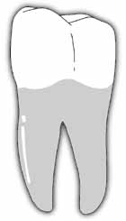
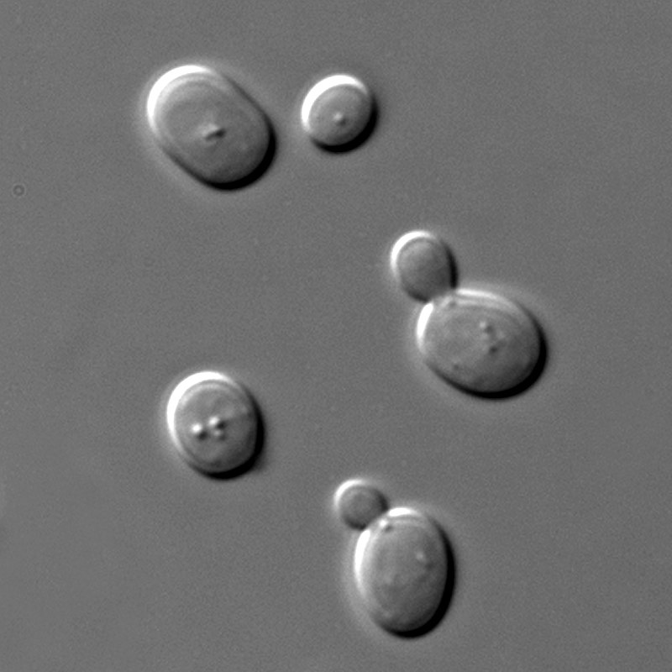
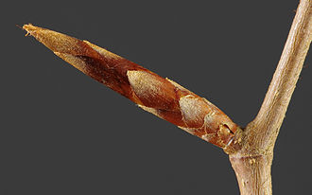
Why is GO useful?
Disambiguate language
The same name is used for different concepts
Different names describe the same concept
Citric acid cycle, tricarboxylic acid cycle, TCA cycle, Krebs cycle
This makes comparisons across species or databases difficult
≠
≠
Tooth bud initiation
Cell bud initiation
Flower bud initiation

Slide 7
GO facilitates gene specific data aggregation
Allows systematic capture of gene-specific knowledge
Curate detail, annotating genes to ‘terms’
Involves time-consuming curation/annotation activities
Literature searching, database searching, sequence analysis…
165.000+ publications annotated for GO
Gene 1
Nucleus
DNA repair
Exonuclease
Gene 6000
Fumarase
TCA cycle
Mitochondrion
Gene 3
Kinase
Cell cycle
Cytosol
Gene 2
Kinase
Signaling
Cytosol
Gene 5
Fumarase
TCA cycle
Mitochondrion
Data aggregation on this scale is not feasible for individual research groups
Gene 4
Detoxification
Peroxidase
Notes:
Not efficient to do at scale

Slide 8
GO allows grouping genes by feature
Essentially creating lists of genes with similar features
Useful to plan experiments
What genes encode protein kinases…
Analysing data
Identifying trends (enrichments)
What do the genes in my screen have in common…
Gene 1
Nucleus
DNA repair
Exonuclease
Gene 3
Kinase
Cell cycle
Cytosol
Gene 2
Kinase
Signaling
Cytosol
Gene 6000
Fumarase
TCA cycle
Mitochondrion
Mitochondrion
Gene 1
Gene 2
Gene 5
Gene 5000
DNA repair
Gene 1
Gene 3
Gene 10
Gene 100
Protein Kinase
Gene 5
Gene 12
Gene 20
Gene 2000
Gene 4
Detoxification
Peroxidase

Slide 9
FAIR - four founding principles for good data management
Guidelines to improve the Findability, Accessibility, Interoperability, and Reuse of digital assets.
The principles refer to three types of entities: data (or any digital object), metadata (information about that digital object), and infrastructure.
Findable:
Metadata and data should be easy to find for both humans and computers.
Machine-readable metadata are essential for automatic discovery of datasets and services.
Associate data with identifiers, metadata, & deposit/index in a searchable repository
Accessible
Once the user finds the required data, she/he/they need to know how they can be accessed, possibly including authentication and authorisation
Metadata is retrievable and accessible using standardized protocols
Interoperable
Data needs to be integratable with other data & interoperate with applications or workflows for analysis, storage, and processing.
Metadata and data described using accessible and widely acceptable/domain-specific language
Reusable
The ultimate goal of FAIR is to optimise the reuse of data.
Well-described metadata and data so they can be replicated and/or combined in different settings.
Clear data provenance & usage license
The FAIR Guiding Principles for scientific data management and stewardship. Wilkinson et al (2016) PMID:26978244
Notes:
Locating and accessing data within special-purpose repositories is not always straight-forward (may be difficult to query, extract and integrate datasets).
The FAIR data principles were developed as an attempt to provide data producers and repository curators with a set of guideposts to increase the degree of data discoverability and re-usability

Slide 10
Ontologies
Help us build standards for terms used in a particular domain
Consists of several parts:
Classes / entities / terms
Metadata
Relationships
File formats
Axioms

Slide 11
Ontology parts: Classes
Basic unit within an ontology, representing things within a domain
Eg. endocytosis, hydrogen peroxide, fragile X syndrome
Associated with stable and semantics-free identifiers to promote stability even though ontology representation may change with new scientific knowledge
e.g. GO:0006897, CHEBI:16240 and MONDO:0010383 or OMIM:300624 or DOID:14261)
Classes may be merged
Alternate IDs maintained as secondary identifiers
Classes may be obsoleted
Shouldn’t be used for further annotation, but kept for historical records
Obsolete classes may contain metadata pointing to alternative classes

Slide 12
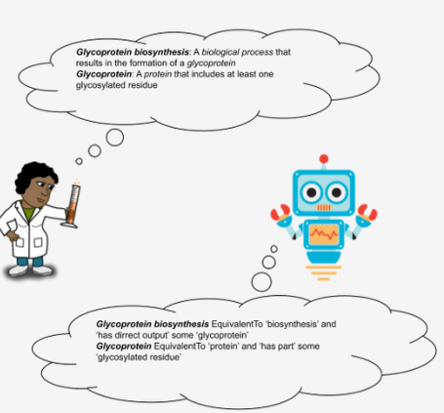
Ontology parts: Metadata
Information associated with classes
Term definition: Both a textual definition (aimed primarily at humans) and logical definition (aimed primarily at machines)
Curators must always annotate to the term definition, not the term name
Good definitions are important:
Promote inter-curator annotation agreement
Facilitates integration: Allows non-experts and experts in adjacent disciplines to understand unfamiliar terms, enabling use of terms from external ontologies
Allow ontology developers to use assisting tools such as “reasoners” (more later in “tools”)
From C. Mungall’s blog post: OntoTip: Write simple, concise, clear, operational textual definitions
https://douroucouli.wordpress.com/2019/07/08/ontotip-write-simple-concise-clear-operational-textual-definitions/

Slide 13
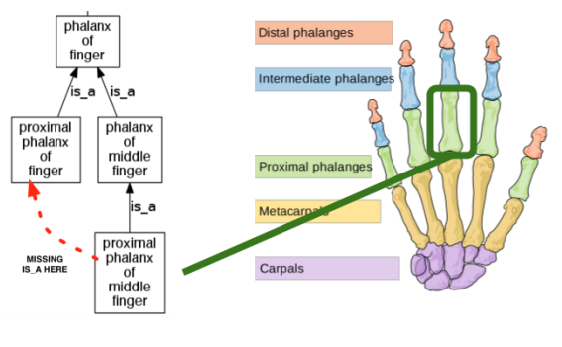
Why is multiple inheritance preferred over single inheritance?
Classification of proximal phalanx of middle finger (PPoMF)
is-a links are shown as black arrows
missing is-a relationship indicated with a dashed red line
If a phenotype involving the proximal phalanx of middle finger (PPoMF) is annotated, and a user queries for proximal phalanx of [any] finger (PPoF), the user will not get the expected results.
The missing relationship is from a single-inheritance ontology - the missing relationship is by design.
Example from C. Mungall’s blog post “Single-inheritance principle considered dangerous:
https://douroucouli.wordpress.com/2019/05/10/ontotip-single-inheritance-principle-considered-dangerous/
Notes:
Foundational Model of Anatomy Ontology (FMA) -Human anatomy ontology

Slide 14
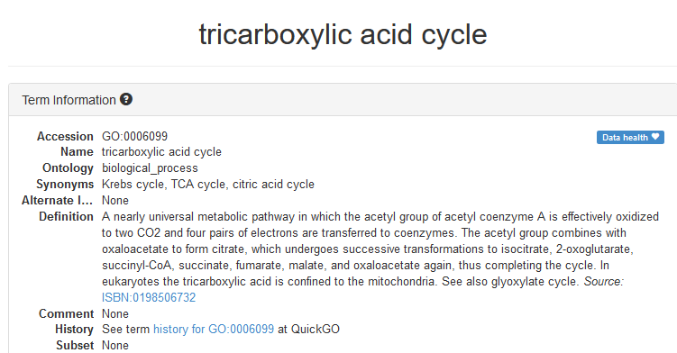
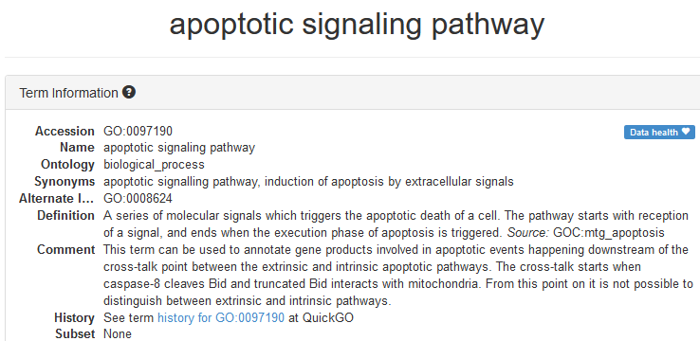
Ontology parts: Metadata
Information associated with classes
Secondary IDs: resulting from term merges), obsoletion flags, synonyms, cross-references to alternative databases
Synonyms come in different types, e.g. exact, related, narrow
Different ontologies might cross-reference other ontologies for different reasons!
e.g. GO cross-references EC and Rhea and links to publications supporting the existence of the class, other ontologies may cross-reference chemical compounds participating in a reaction)
May contain comments and examples of intended usage

Slide 15
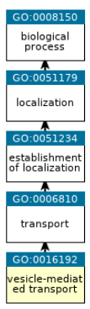
Ontology parts: Relationships
general
Classes are arranged in a hierarchy from general to specific
Relations between classes provide structure to the ontology
Broad general/ancestor/parent terms give rise to specific/descendant/child terms
Important since relationships within the ontology enable transitive inheritance of annotations
I.e. when annotating to a more specific class, the annotated feature (such as a protein, or a drug) is automatically annotated to all the more general classes
A search to a parent term can retrieve all children
Every possible path from a term back to the root node must be accurate, or the ontology must be revised
specific
Notes:
QuickGO representation of term ancestry

Slide 16
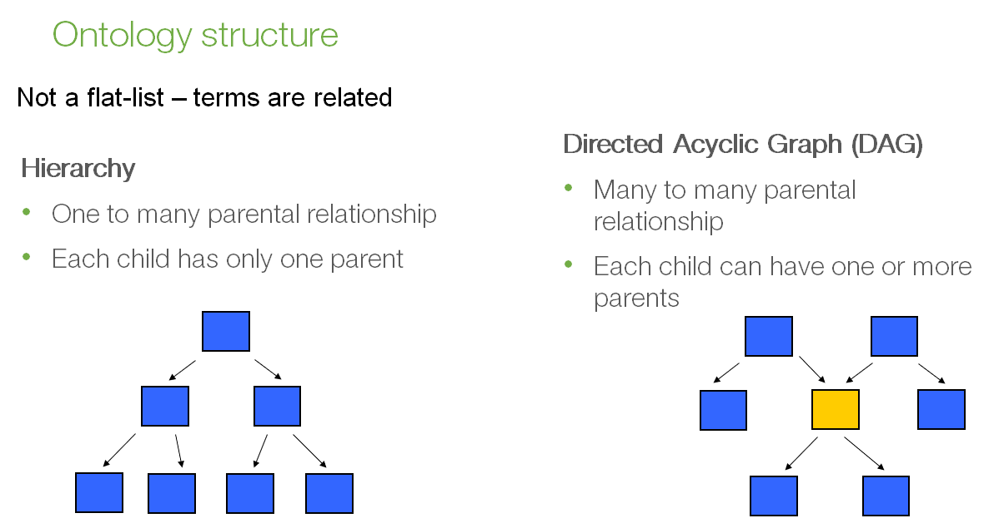
Ontology parts: Relationships & ontology structure
Relationships link together terms in the ontology
Ontologies can take on a simple tree structure (hierarchy)
Most bio-ontologies are structured as more complex directed acyclic graphs (DAGs)
Hierarchy
Parent: one to many children
Child: only one parent
Relationship: is a
DAG
Many to many each direction
Many relationship types
No circles
Notes:
Most ontologies are not simple trees. Rather they are structured as DAGs - classes can have multiple parents

Slide 17
Ontology parts: Relationships
Relationships common to many ontologies
Is_a: is a subtype of
A volvo is_a car
The mitochondrion is an organelle
Part_of:
A wheel is part_of a car
The mitochondrial lumen is part_of the mitochondrion
Notes:
Vesicle mediated transport is a transport, is a establishment of localization
Vehicle car bike boat

Slide 18
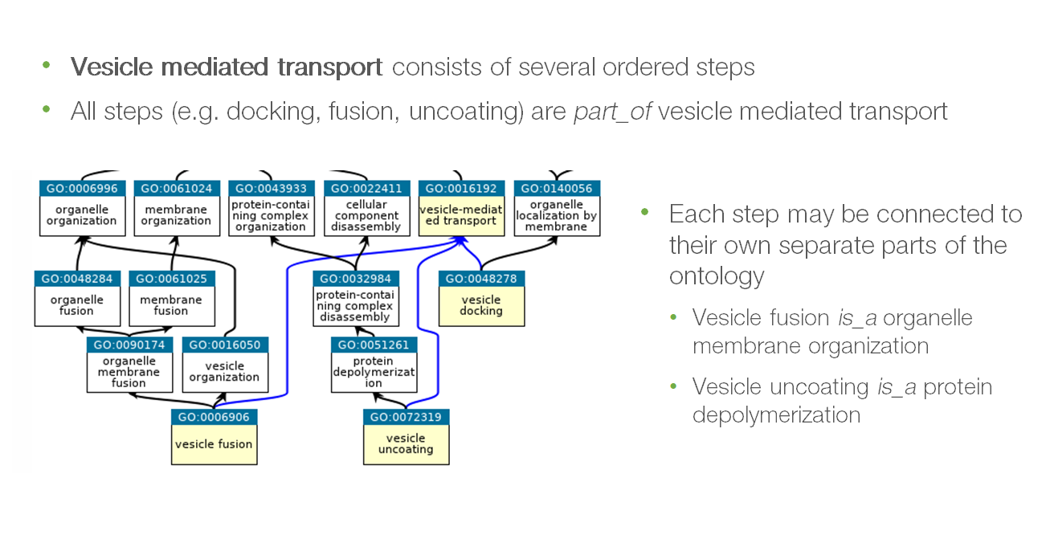
Acyclic – no circles allowed
Ancestors are inherited
>40.000 terms across the three ontologies

Slide 19
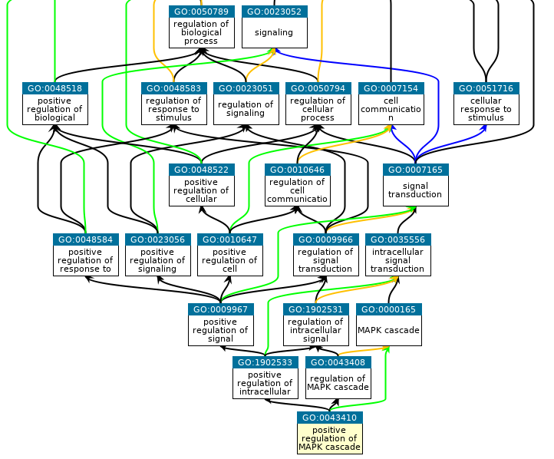
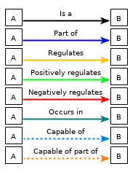
Notes:
Regulates relationship

Slide 20
Annotation inheritance
An important feature of GO is that broader parents give rise to more specific children.
When a gene is directly annotated to a term it is automatically indirectly annotated to all its parent terms …therefore a search on a parent retrieves children
E.g. all genes annotated to “mitochondrial lumen” are also annotated to “mitochondrion”
Every possible path from any term back to the root node must be biologically accurate, or the ontology must be revised

Slide 21
Functional biocuration
A functional annotation is the association of a feature (e.g. a gene) with an ontology term
A statement that a gene product performs a specific function, localizes to a particular structure, or participates in a specific pathway
Currently 1 billion+ GO annotations
Two main aspects
Literature curation (reading full text publications and associating novel biological information with the appropriate genes or features)
Sequence analysis (infer information for unpublished genes)
Manual curation
Curators from annotation groups (e.g. ZFIN, UniProt) create annotations based on published experiments
Low throughput
Annotations are then transferred to orthologous genes (manually or automatically)
Electronic pipelines (bulk annotation)
Many are based on interpro signatures (InterPro2GO) or 1:1 orthologs from Ensembl gene trees.
Typically results in high level, but high quality, annotations (PMID:22693439)
High throughput
Notes:
Sequence feature curation vs functional curation
1:1 orthologs inferred from Ensembl gene trees, an approach which automatically transfers annotations found experimentally in one gene, to its 1:1 orthologs in the same taxonomic clade

Slide 22
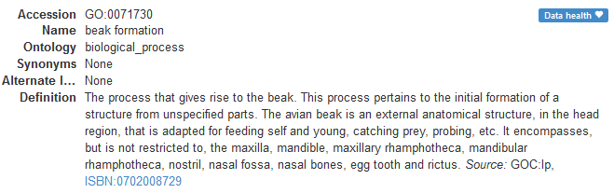
Caution
Not all annotations are transferred to all species, even if genes have a 1-to-1 orthologous relationship.
Would be incorrect to transfer this annotation from chick BMP4 to human BMP4

Slide 23
Evidence codes – describes how an annotation is supported
Many types, only a subset listed below. http://geneontology.org/docs/guide-go-evidence-codes/
Experimental – evidence from wet-lab experiments - e.g:
IDA: Inferred from Direct Assay – enzyme assays, immunofluorescence
IMP: Inferred from Mutant Phenotype – comparison of differences in phenotypes from two different alleles
Computational
ISO / ISS – Inferred from Sequence Orthology / Similarity
Phylogenetic
IBA – Inferred from Biological aspect of Ancestor - phylogenetic analyses to transfer annotations amongst related sequences based on common ancestry
“No evidence”
IC – Inferred by Curator
Author statements
Automatic
IEA – Inferred from Electronic annotation – automatic transfer of annotations based on the presence of sequence features or on orthology. The annotations are not manually reviewed.

Slide 24
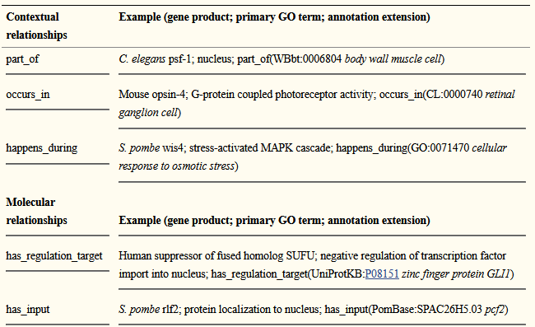
Beyond basic GO annotation:
Annotation extensions
Provides additional detail to GO annotations
E.g. the target gene or the location of a molecular function
Provides curated, directional links between gene products
supports network construction
Huntley et al. PMID:24885854

Slide 25
Beyond basic GO annotation:
Causal Activity Modeling (GO-CAM)
Provides a framework to link GO annotations in integrated models of biological systems
A GO annotation is the association of a gene product with a term in the 3 ontologies
In GO, what gene products do (Molecular Functions) are distinct from the larger biological programs they are part of (Biological Processes) and where they take place (Cellular Components)
For traditional GO annotation there has been little representation of how annotations to one gene fit together
Provides a system for formalizing and extending GO annotations
Enables pathway visualisation
Documentation: http://geneontology.org/go-cam

Slide 26
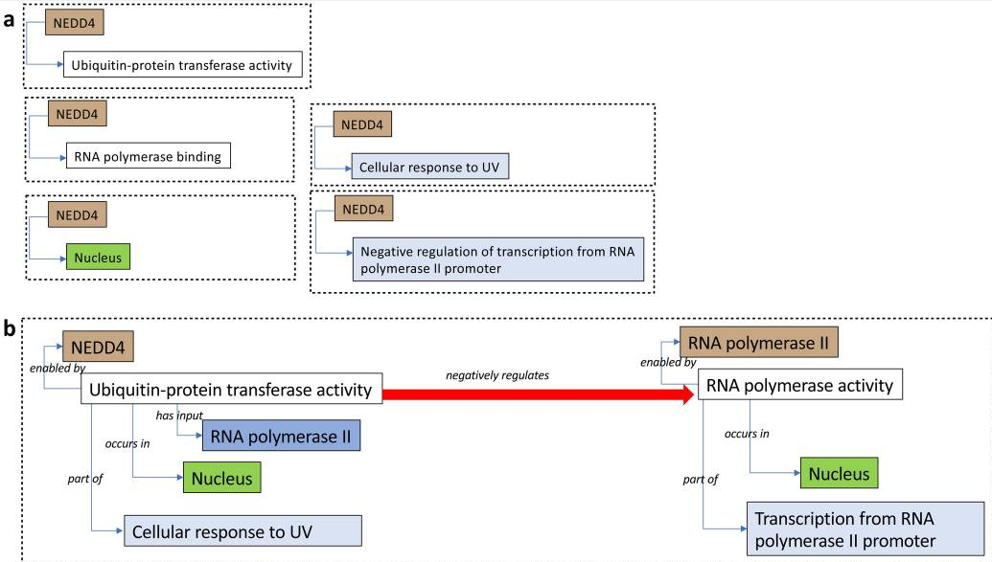
More complex statements can be represented
Set of disconnected annotations vs. a model linking the GO annotations
Combines multiple simple GO annotations into an integrated, semantically precise and computable model of biological function
Thomas et. al PMID:31548717
Notes:
Historically simplicity was beneficial, has contributed to the success of the GO project

Slide 27
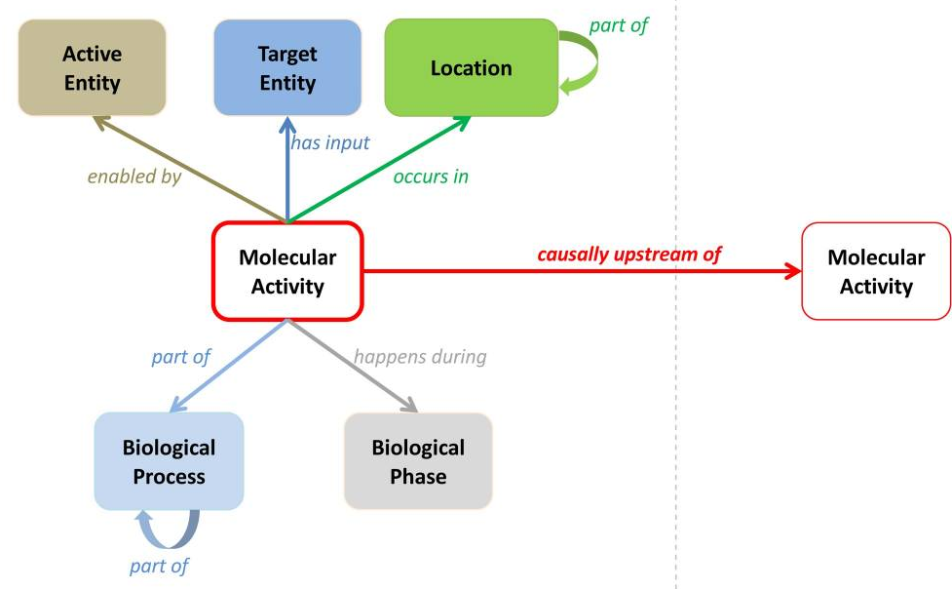
More complex statements can be represented
Centres on a molecular activity
….carried out by a gene product or complex (brown)
…that may act on another entity (dark blue)
…the activity occurs in a location (green)
…and part of a specific biological program (blue)
……which may be part of a larger process or phase, or anatomical structure or cell type (curved arrow)
…and may have causal effects on other molecular activities (red arrow)
……effectively creating networks of activities
Thomas et. al PMID:31548717

Slide 28
Accessing GO annotations
GO downloads http://current.geneontology.org/products/pages/downloads.html
Browsers
ZFIN https://zfin.org/
QuickGO https://www.ebi.ac.uk/QuickGO/
AmiGO 2 http://amigo.geneontology.org/amigo
File formats
A GAF (Gene Association File) is a GO annotation file containing annotations made to the GO
The GPAD - Gene Product Association File Format - is an alternative means of exchanging annotations from the GAF. The GPAD format is designed to be more normalized than GAF.

Slide 29
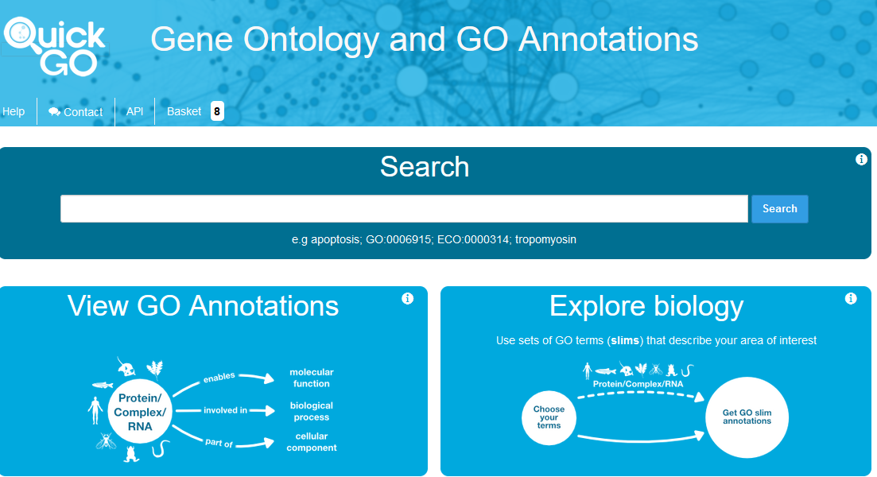
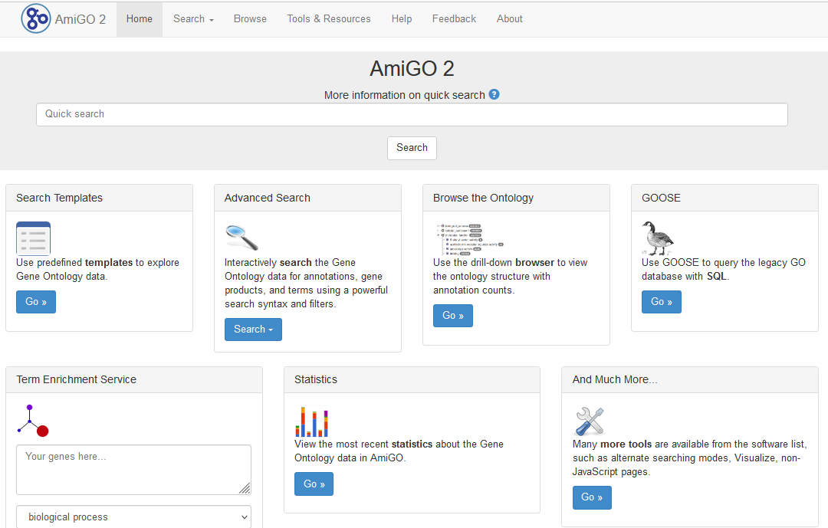
Ontology and annotation browsers
Two main generic browsers: QuickGO and AmiGO
QuickGO (EMBL-EBI)
https://www.ebi.ac.uk/QuickGO/
Nice graphical view for term browsing
Webinar: https://www.ebi.ac.uk/training/events/quickgo-gene-ontology-annotation/
Tutorial: https://www.ebi.ac.uk/training/online/courses/goa-and-quickgo-quick-tour/#vf-tabs__section--gettingstarted
AmiGO (GOC)
http://amigo.geneontology.org/amigo
Easy access to annotations with faceted search

Slide 30
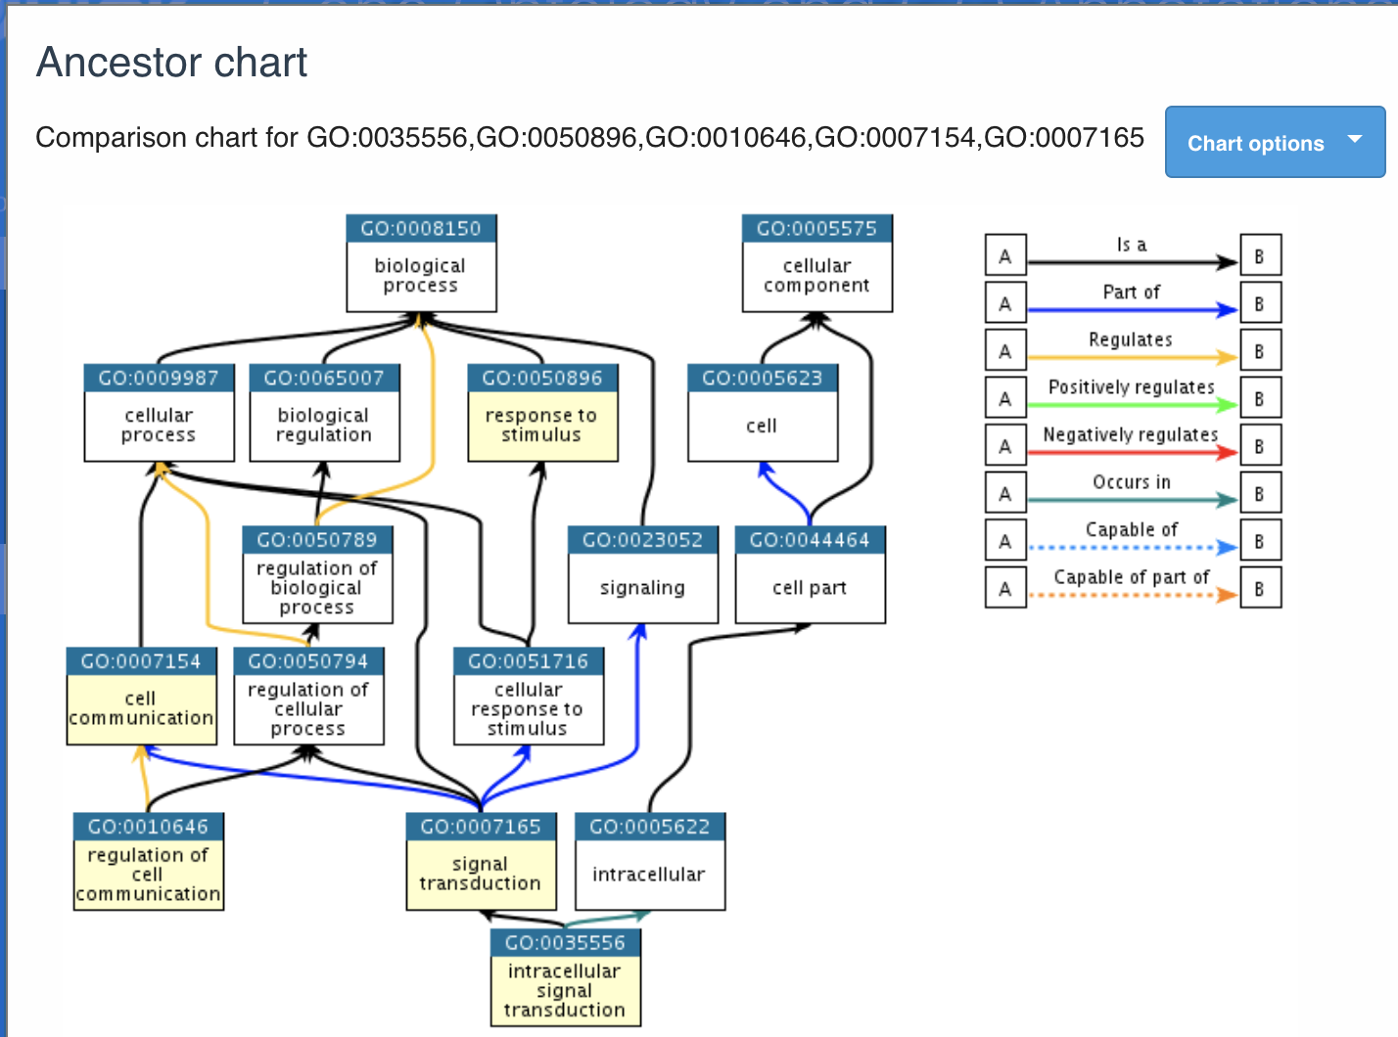
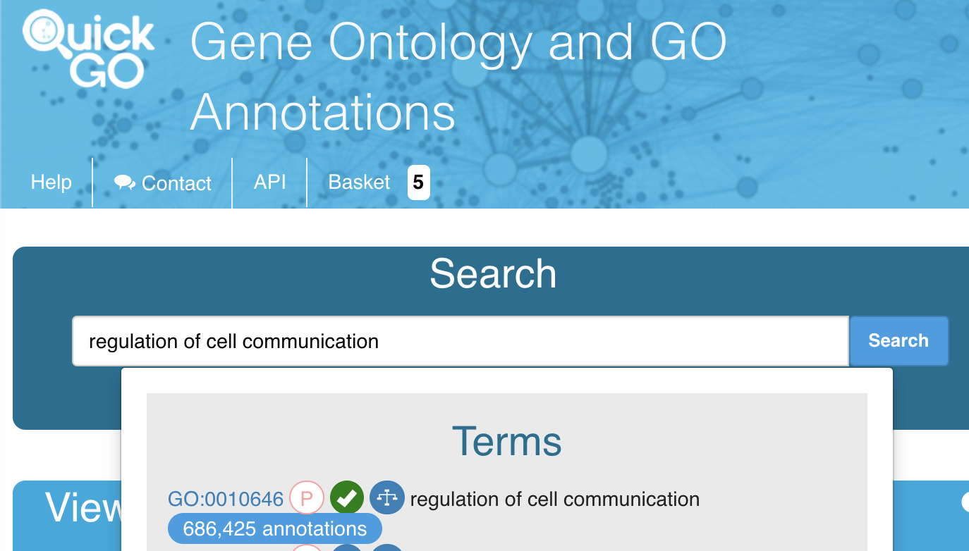

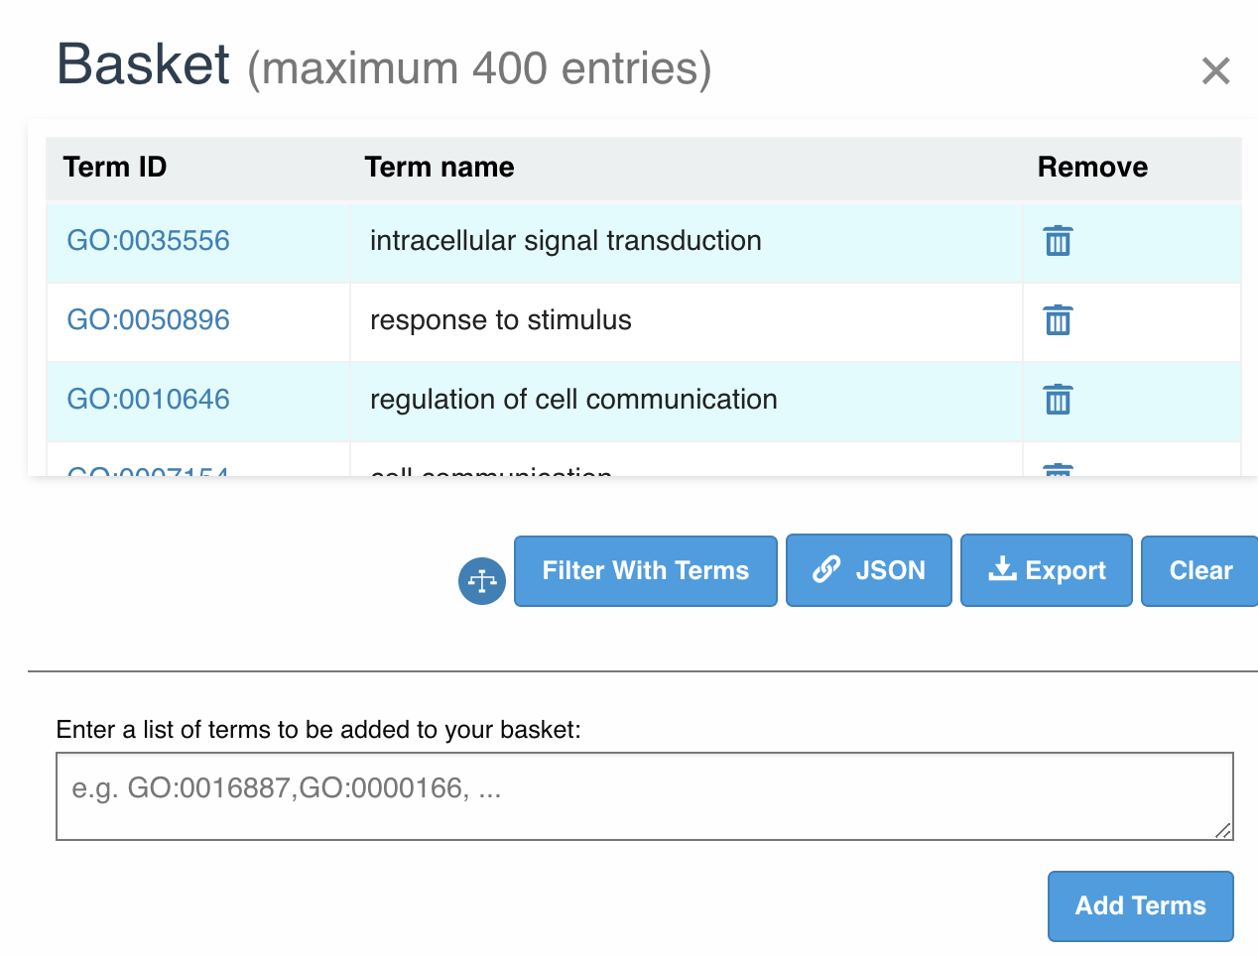
QuickGO ancestor view

Slide 31
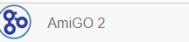
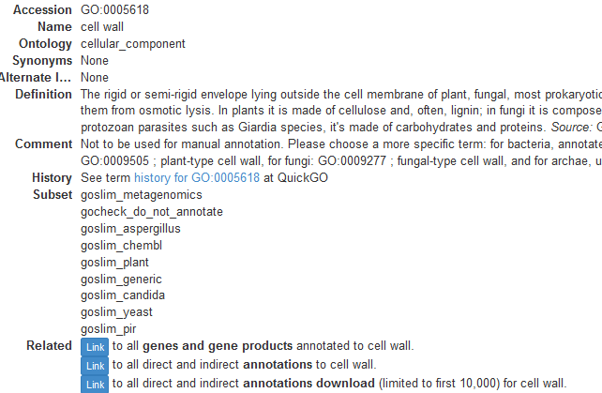
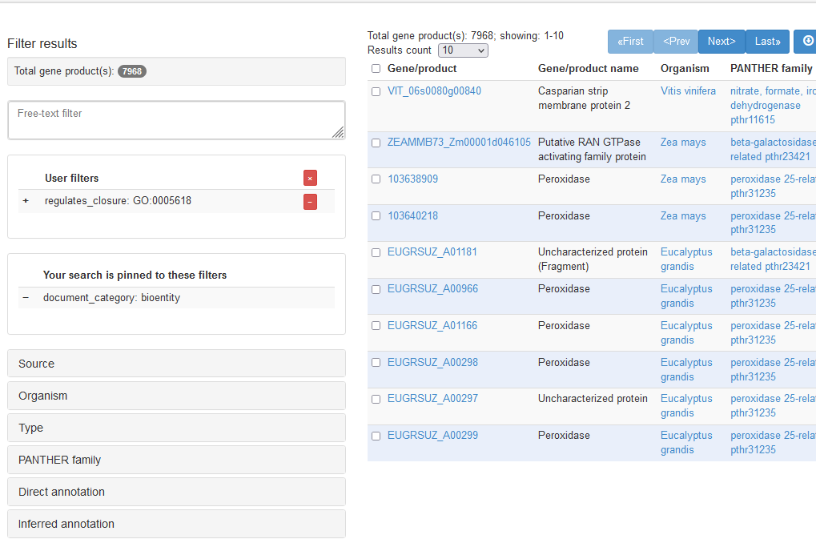
AmiGO – species filter

Slide 32
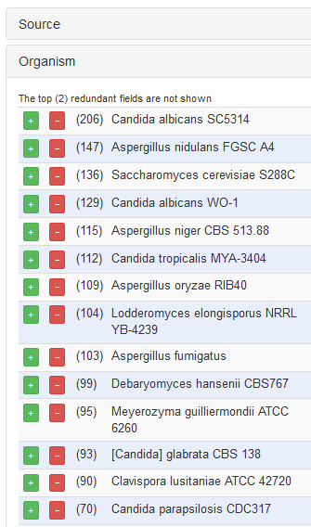
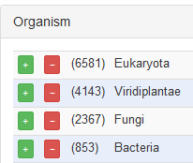
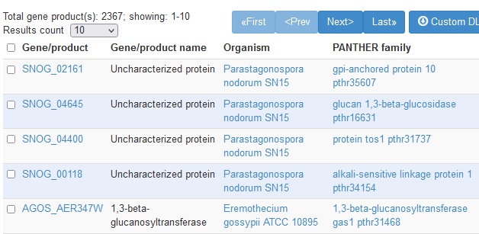
AmiGO – species filter

Slide 33
Difference between AmiGO and QuickGO (beware)
Gene-centric or protein-centric worldview
In UniProt GOA (and consequently in QuickGO) annotations are made to proteins, and there may be multiple proteins per gene, sometimes representing different isoforms.
GO Central omits the majority of the sequences and IEA [electronic] annotations from UniProtKB from the weekly database builds due to the large size of the data set.

Slide 34
Ontology and annotation uses
Aids searching
Data integration
Data analysis
Data visualization

Slide 35
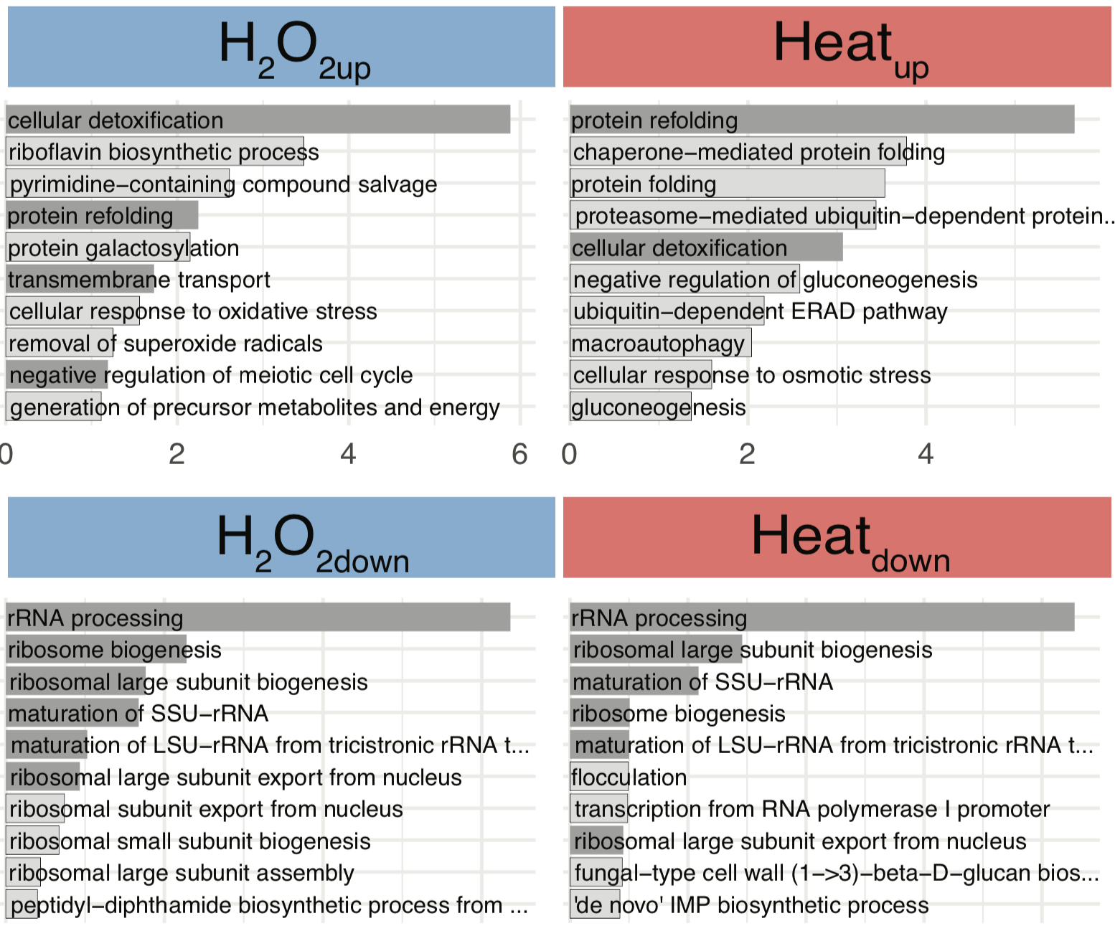
Enrichment analysis
Find significantly overrepresented terms among a list of genes
What do genes in a gene list have in common?
Compare the annotations to your gene list with the annotations to the entire gene set to see if any terms are over or under represented compared to the background
E.g. 100 genes identified in an experiment, if 4/5 annotated to ‘galactose metabolism’ are identified, this is highly significant
An enrichment provides enriched terms and a statistical measure of how likely your genes (result set) fall into that category by chance
Thodberg et. al 2019 PMID:30566651

Slide 36
Components
GO annotations
Gene list of interest - phenotype screen, differentially expressed genes across conditions or WT vs mutant, interacting genes, etc
Background (/reference) gene set -Set of all genes that could have been detected in the experiment. Do NOT include genes in the background set that couldn’t have been identified in the screen
e.g. if you identified proteins with a specific protein modification then do not include ncRNA genes in your background
e.g. if a microarray only contained a subset of genes, then these are the background
Some tools:

Slide 37
Enrichment Tools
Many different tools available
GO tool (Panther): http://pantherdb.org/webservices/go/overrep.jsp
Princeton: http://go.princeton.edu/cgi-bin/GOTermFinder
G:profiler: http://biit.cs.ut.ee/gprofiler/gost
It is worth comparing results from multiple tools (look/feel, agreement, etc)
Notes:
Some allow uploading custom files, some don’t

Slide 38
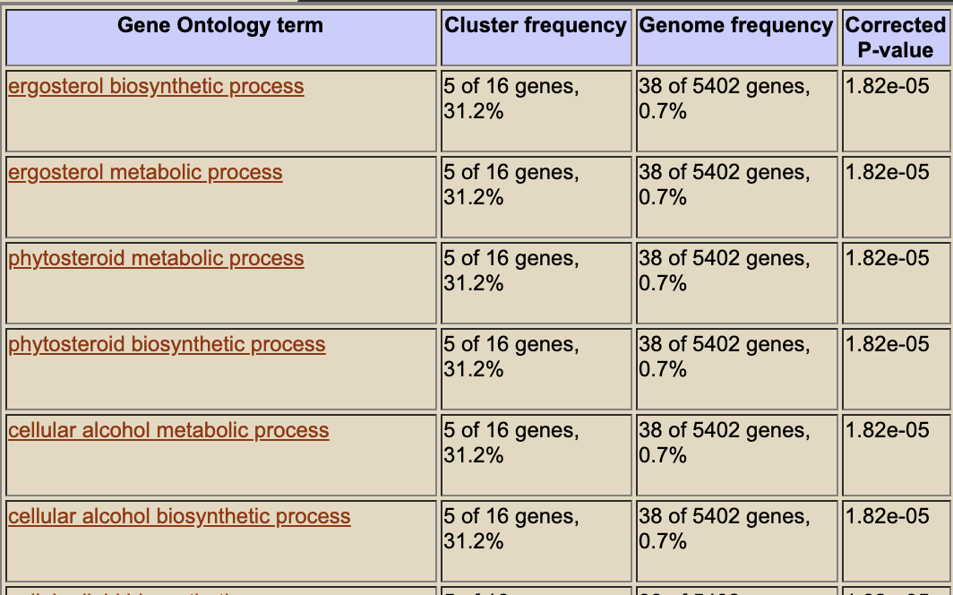
Results
Number of genes annotated to the GO term in the list of interest
Number of genes annotated to the term in the background set
The probability of seeing at least X genes in the list of interest annotated to a specific GO term, considering how commonly it is annotated in the background set
The closer the value is to zero the less likely it is to be observed by chance
Repetition

Slide 39
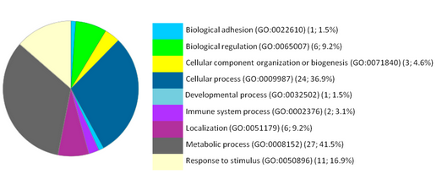
Results
List of terms enriched in data-set
List needs to be evaluated
Physiological relevance?
High level terms are often uninformative (for physiological role)
Pinpoint ancestor/child terms

Slide 40
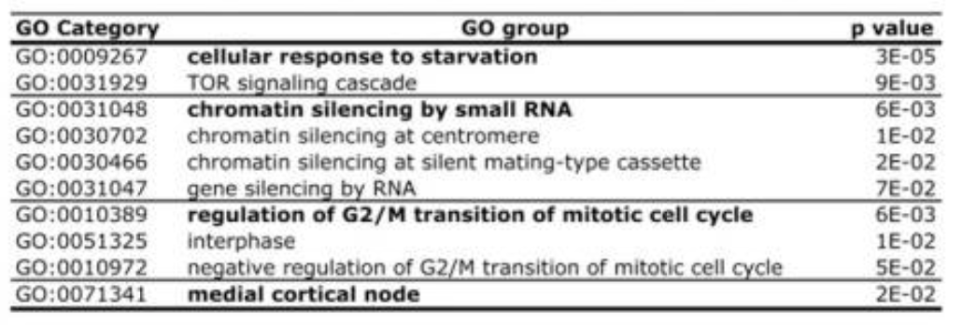
Filter very similar terms out to narrow down the list
Grouping related terms and concepts
“significant enrichment of four distinct functional groups encompassing the regulation of the cell cycle, cytokinesis, response to nutrients, and chromatin modifications at the centromere” - Bauer et. al 2012 PMID:22768388

Slide 41
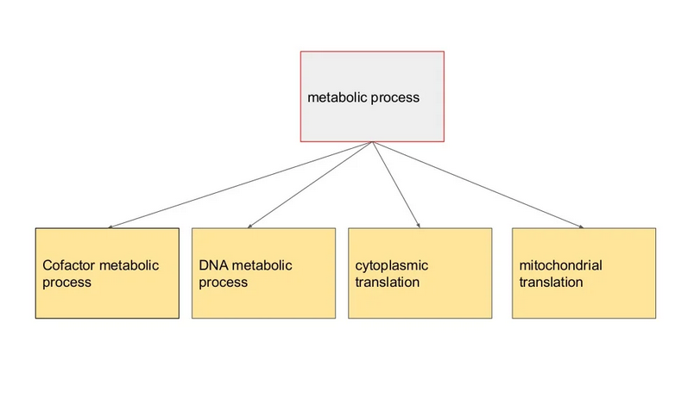
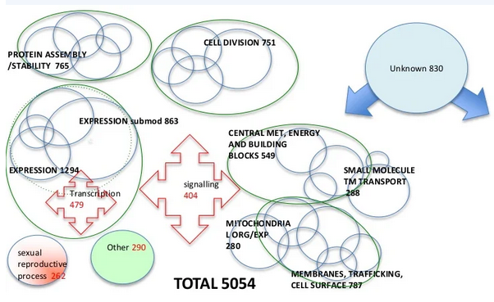
High level terms are often uninformative (for physiological role)
Very high level terms lump unrelated concepts
Biological “modules” generally do not overlap

Slide 42
GO subsets (GO slims)
Mapping granular annotations of a set of genes to high-level (more general) parent terms
A coarse-grained overview of detailed annotation
Possible because high-level terms are inherited
Useful for visualizing broad annotation categories for a gene list / entire genome, or to summarize a dataset
Notes:
slim is not a gene product count, its an annotation count
because gene products can have multiple anotations to different processees (5000 genes 8454 annotations)
Use histograms histogram (absolute numbers) (not use pie charts %, not % of genome, percentage of annotations)

Slide 43
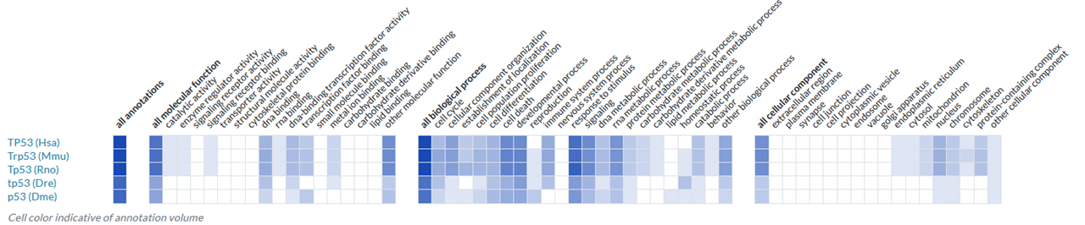
Common uses of subsets/slims
1. Whole genome slims
Summarises an organism’s biology
A resource for planning curation (or research) – enables identification of unannotated or uncharacterized genes
Needs to be biologically relevant and redundancy minimized
Coverage needs to be as good as possible
https://www.alliancegenome.org/gene/HGNC:11998#function---go-annotations

Slide 44
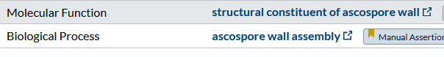
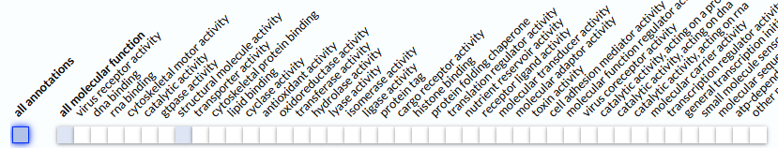
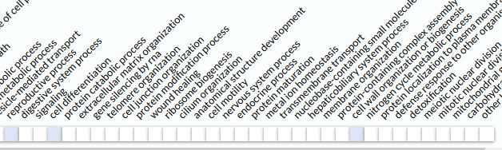
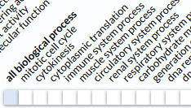
2. Single gene overview
E.g. ribbon display
Indicates branches of GO applicable to gene
High level grouping terms – redundancy matters less

Slide 45
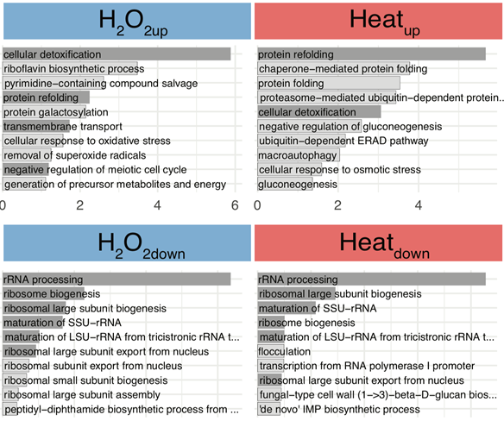
Thodberg et al. (2019) PMID:30566651
Compared differentially expressed genes across different conditions (genes downregulated in hydrogen peroxide shown)
3. Slimming results from an analysis
To aid interpretation of results (e.g. results from an enrichment)
Data display/result summary – smallest possible table that will convey the message

Slide 46
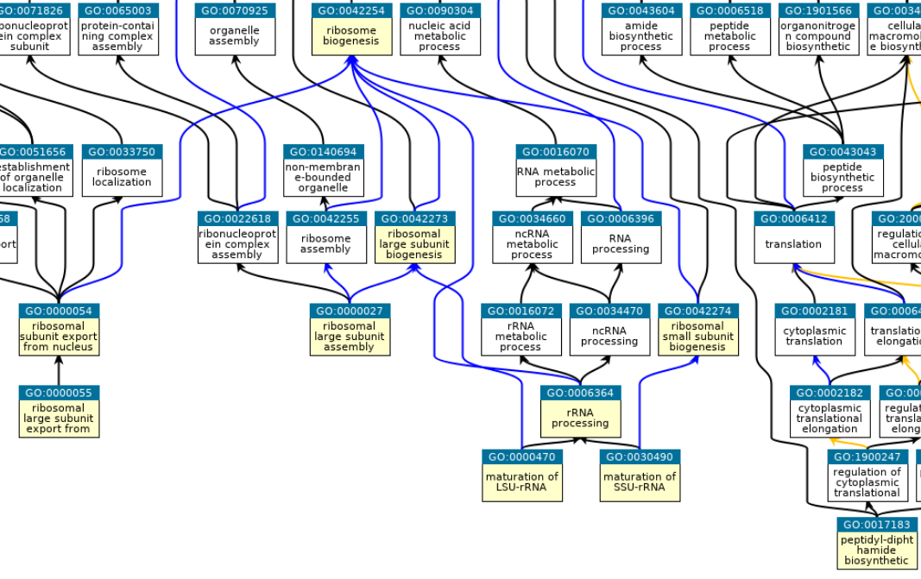
QuckGO “ancestor tree” view for the 10 ontology terms enriched among genes that are downregulated in H2O2
https://www.ebi.ac.uk/QuickGO

Slide 47
Take the knowledge of the structure of the ontology to “slim down” the results for condensed data-display
Ribosome biogenesis
Translation

Slide 48
Ready made subsets are available at the GO site
Includes (among others) species-specific genome subsets as well as a generic GO subset
http://geneontology.org/docs/download-ontology/#subsets
No “one size fits all” - you can create your own GO slim with terms of interest
http://go.princeton.edu/cgi-bin/GOTermMapper
Map2Slim script https://github.com/owlcollab/owltools/wiki/Map2Slim

Slide 49
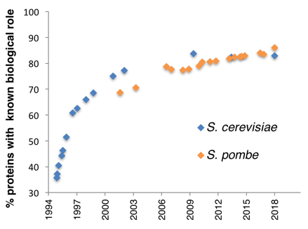
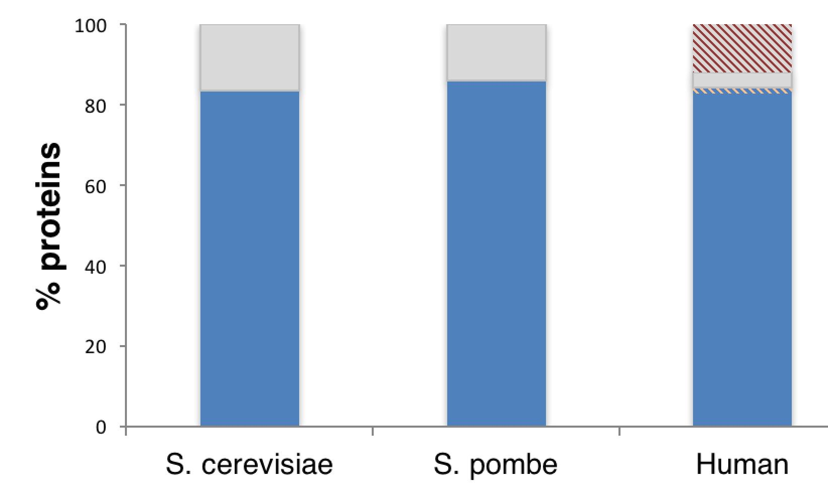
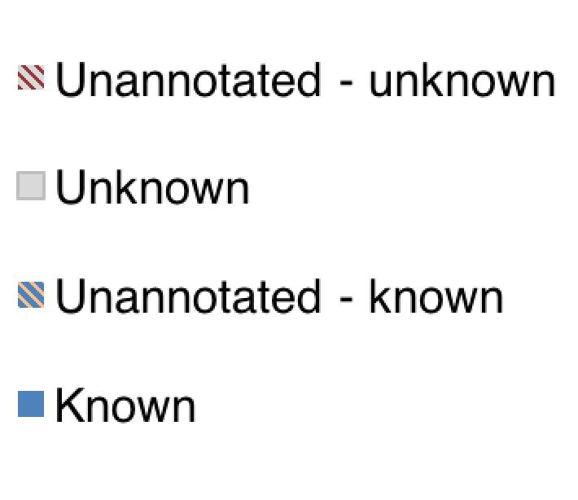
Slimming tips
Only slim one aspect (molecular function, biological process or cellular component) at a time
Minimise genes that do not slim – unannotated, unknown, unslimmed?
Hidden in plain sight: what remains to be discovered in the eukaryotic proteome? PMID:30938578
New gene characterization is slow!
20% of genes are still unknown Biological Process (- do not slim to any ‘biologically informative’ genome slim terms)
70% of human research is on proteins known pre-genome sequencing (PMID:21307913)

Slide 50
Slimming tips
Only slim one aspect (molecular function, biological process or cellular component) at a time
Minimise genes that do not slim – unannotated, unknown, unslimmed?
Terms must be picked manually
There are no readily identifiable ‘levels’ in the ontology
Avoid going too high (terms that slim most genes - biologically uninformative)
Lump vs. split – Some terms have a common parent in the ontology, but are largely unconnected in terms of gene sets
Nuclear gene expression vs. mitochondrial gene expression
Vesicle-mediated transport vs. nucleocytoplasmic transport

Slide 51
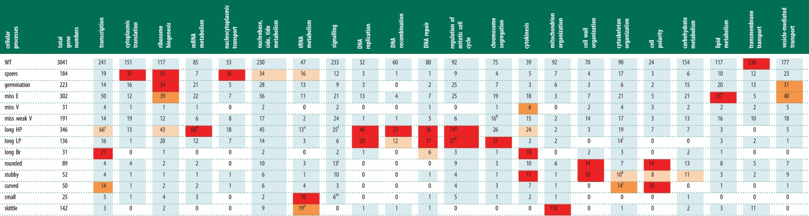
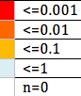
Lump vs. split, real example
Adapted from Hayles et al 2013 PMID:23697806
Genome-wide deletion mutant phenotype screen
GO analysis to identify genes annotated to cellular processes enriched within phenotype categories.
The enrichment results were mapped to ‘GO slim’ (high level) terms
Mitochondrial translation
Some phenotypes (horizontal) are significantly enriched for specific GO processes (vertical)

Slide 52
Problems & pitfalls
Versioning: GO (the ontology) and GO annotations are changing daily, check the date stamp on the ontology and the dataset you are using
Not all genomes are comprehensively annotated
Unknowns are ignored by enrichment tools, and these might be interesting genes in your list
Be aware of evidence codes – e.g. include RCA (computational predictions) – more false positives
Don’t exclude electronic annotation codes (important for unannotated genes)
Analysis shows that they are as accurate as manual annotation, just not as specific (PMID:22693439)
Enrichment: use the correct background set (the set of genes in your “experiment”) - If you used the whole protein set you need to filter for ncRNAs…
Slimming: GO annotations are NOT mutually exclusive, therefore it doesn’t make sense to put in a pie chart and show as distribution as percentages (it is an annotation number total, not a gene product count)
Slimming: Consider genes that are annotated but not to terms in your slim set (you may need to define a better slim set)
Further reading
PMID:18475267 Use and misuse of the Gene Ontology
PMID: 24244145 Ten quick tips for using the gene ontology.
Notes:
slim is not a gene product count, its an annotation count
Use histograms histogram (absolute numbers) (not use pie charts %, not % of genome, percentage of annotations)

Slide 53
GO help and contact
GO helpdesk (questions/feedback): http://help.geneontology.org
FAQ: http://geneontology.org/docs/faq/
Documentation: http://geneontology.org/search.html
Technical questions and accessing GO codes: https://github.com/geneontology
GO REST API (support common queries to GO): http://api.geneontology.org/api
GO SPARQL (support common queries to GO-CAMs): http://sparql.geneontology.org

Slide 54
What about genomes with no GO annotation?
Currently, GO recommends groups submit their transcriptomes to NCBI. These submissions will reach UniProt, where InterPro2GO automatically creates GO annotations. These annotations, made with the IEA evidence codes (Inferred from Electronic Annotation), will be made available in a future GO release.
GO does not recommend groups create their own IEAs with internal tools due to reproducibility and accuracy concerns.
http://geneontology.org/docs/faq/#how-do-i-annotate-a-novel-genome-with-go-annotations
But what if people want to summarize it's functional capabilities using GO as part of a publication? I would recommend:
For a very basic first pass run interProscan and then use InterPro to GO mappings.
2. If there is a well annotated model, and they can generate a good orthology mapping they can do direct transfer -similar to what we did for japonicusDB https://academic.oup.com/genetics/advance-article/doi/10.1093/genetics/iyab223/6481558?login=false
3. For high quality annotations use PAINT and tree grafter (best way to get specific annotation if there is no close relative with good annotation coverage) https://academic.oup.com/bioinformatics/article/35/3/518/5056037
None are trivial, but presumably a project of that sort would have some provision for bioinfomatics support.
Personally I would not trust any tools which used blast or similar but others may have recommendations of tools that work well.

